Slide 1
Distributed Programming Lecture 7b
Andrea Valente
anva@mmmi.sdu.dk

Slide 2
Topics
Reference book: Learning jQuery 4rd edition
Dynamic HTML
parsing HTML, a tree of HTML nodes
javascript and the browser: sharing a tree
how to represent a tree as a data structure?
basic operations on a tree and its nodes?
visiting a tree
Concepts: Objects, trees, high-order functions, recursion, tree traversal, DOM, selection and insertion

Slide 3
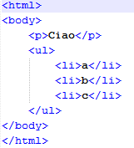

The problem
Consider this simple page
How can we:
change style to all <li> elements?
select all <li> elements and return them in a list/array?
Suggestions?

Slide 4
Enter jQuery
Folder: 01_jQuery selectors
Short and simple, but... How does jQuery do it?
To understand we need to:
be able to go from (HTML) text to DOM
and because a DOM is a tree data structure (a tree of objects) -> define a tree as an ADT in Javascript
be able to visit (or traverse) a tree ... and find data inside it
shortly recall how the HTML DOM works
learn some of the tricks jQuery uses

Slide 5
(1) From text to DOM
Parsing: a form of de-serialization (like in JSON)
For more info on parsing ”Notes on How Parsers and Compilers Work”: http://parsingintro.sourceforge.net/
parse
text
Some data structure
print or save
HTML
DOM

Slide 6
The effect of parsing HTML
html
PARSE
Suggestions?

Slide 7
The effect of parsing HTML
html
PARSE
body
p
ul
il
il
il
How to represent that tree in Javascript?
text
”a”
text
”b”
text
”c”
Suggestions?

Slide 8
(2) The tree ADT
DEF: “… a tree has a value and children, and the children are themselves trees…”
Operations: it should be possible to create an empty tree, add values and reach nodes in the structure
Read more at https://en.wikipedia.org/wiki/Tree_(data_structure)
html
value
body
aTree
child is an entire tree
p
ul
il
il
il
text
”a”
text
”b”
text
”c”

Slide 9
What data to represent the tree?
In Javascript we have numbers, strings, arrays, objects, …
How to represent a node?
How to represent children?
html
body
p
ul
il
il
il
text
”a”
text
”b”
text
”c”
Suggestions?

Slide 10
A tree in Javascript
See the examples in: 02_tree adt
The tree ADT can be made into a library: 02_tree adt/v2 ADT/treeADT.js
html
body
p
ul
il
il
il
text
”a”
text
”b”
text
”c”

Slide 11
(3) Traversing trees
linear data structures (lists or arrays) -> linear traversal method
tree structures can be traversed in many different ways!
Also: order of children is not relevant in a generic tree, it is in a DOM
html
Get a node, print its value
Then repeat for each child
body
p
ul
il
il
il
Suggestions?
(let’s do it together)
text
”a”
text
”b”
text
”c”

Slide 12
(3) Traversing trees
linear data structures (lists or arrays) -> linear traversal method
tree structures can be traversed in many different ways!
Also: order of children is not relevant in a generic tree, it is in a DOM
html
Get a node, print its value
Then repeat for each child
body
p
ul
html, body, p, ul, il , text ”a”, li , text ”b”, li, text ”c”
il
il
il
text
”a”
text
”b”
text
”c”

Slide 13
(3) Traversing trees
linear data structures (lists or arrays) -> linear traversal method
tree structures can be traversed in many different ways!
Also: order of children is not relevant in a generic tree, it is in a DOM
html
Get a node, print its value
Then repeat for each child
body
p
ul
html, body, p, ul, il , text ”a”, li , text ”b”, li, text ”c”
il
il
il
!!NOT THE SAME!!
text
”a”
text
”b”
text
”c”
p, text ”a”, li, text ”b”, li, text ”c”, li, ul, body, html
Get a node, print its children
Then print its value

Slide 14

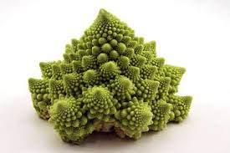

Traversing trees
Note that trees are recursive structures (AKA self-similar structures)
Therefore traversing is (often) easier expressed via recursive functions
node
Children
A node of a tree has children, which are nodes that have children, which are nodes that have children,
...
n
c
Notes:
https://en.wikipedia.org/wiki/Self-similarity

Slide 15
Traversing trees
Note that trees are recursive structures (AKA self-similar structures)
Therefore traversing is (often) easier expressed via recursive functions
node
Children
A node of a tree has children, which are nodes that have children, which are nodes that have children,
...
n
c
Brace yourself!

Slide 16
Recursive functions (recap)
Every recursive solution involves two parts or cases:
Base Cases: in which the problem is simple enough to be solved directly
Recursive Case: which have three components:
Divide the problem into one or more simpler or smaller parts
Call the function (recursively) on each part
Combine the solutions of the parts into a solution for the problem
Example:
To print all elements in an array
Base case: the array is empty -> done!
Recursive case: print the first element of the array, then simply... print the rest (recursion)

Slide 17
Traversing trees
So:
tree structures can be traversed in many different ways
traversing is easier expressed via recursive functions
to print a node:
Get a node, print its value
Then repeat for each child
to print a node:
Get a node, print its children
Then print its value

Slide 18
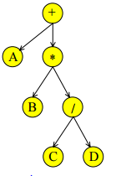
Typical ways to traverse a tree
Pre- , post-order and level- traversing
See: 02_tree adt/v3 traversing
Post-order is great for math expressions...
post-order
A + (B * (C / D) )
Notes:
For more details:
http://www.sqa.org.uk/e-learning/LinkedDS04CD/page_02.htm
http://www.sqa.org.uk/e-learning/LinkedDS04CD/page_13.htm
http://en.wikipedia.org/wiki/Tree_traversal#Types

Slide 19
(3) How to find an element in a tree? (AKA searching)
Example: find the first <li> element from the root. How to proceed?
(or: ”Find all the <li> elements”)
root
html
Suggestions?
body
p
ul
il
il
il
text
”a”
text
”b”
text
”c”

Slide 20
(3) Searching
Using recursion...
See: 02_tree adt/v4 searching

Slide 21
So far...
To understand we need to:
be able to go from (HTML) text to DOM
and because a DOM is a tree data structure (a tree of objects) -> define a tree as an ADT in Javascript
be able to visit (or traverse) a tree ... and find data inside it
shortly recall how the HTML DOM API work
learn some of the tricks jQuery uses
(the last 2 are for next lecture...)
DONE

Slide 22
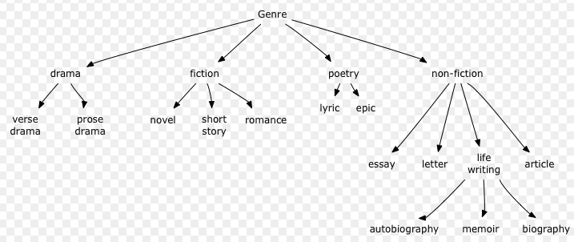
Task ”books”
15 min
Start from: 03_task_books
Change the program in the page so that:
You can define the following tree:
In the body of your document add <div id=”printTree”></div> then modify the printPreOrder function so that it prints your new tree in that div, nicely formatted.

Slide 23
Portfolio
Read the portfolio_2017.txt
Work on your old tasks, start/keep putting together your individual portfolio.

Slide 24
For next time
Check out:
API for DOM nodes: https://developer.mozilla.org/en-US/docs/Web/API/Node.appendChild
Method chaining in javascript https://schier.co/blog/2013/11/14/method-chaining-in-javascript.html
jQuery: nice summary of selectors https://www.w3schools.com/jquery/trysel.asp

